Slide 1
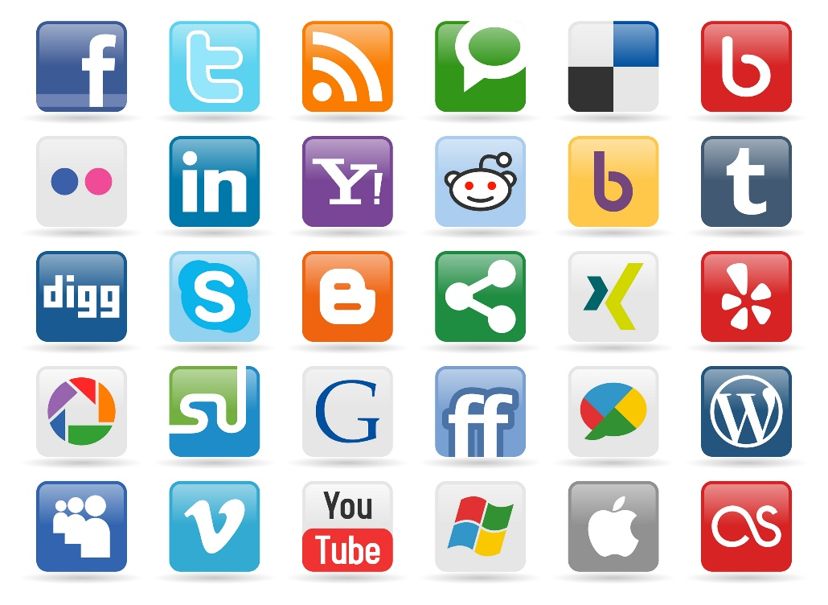

Recommendation in Social Media
SOCIAL
MEDIA
MINING

Slide 2
Dear instructors/users of these slides: Please feel free to include these slides in your own material, or modify them as you see fit. If you decide to incorporate these slides into your presentations, please include the following note:
R. Zafarani, M. A. Abbasi, and H. Liu, Social Media Mining: An Introduction, Cambridge University Press, 2014.
Free book and slides at http://socialmediamining.info/
or include a link to the website: http://socialmediamining.info/

Slide 3
Difficulties of Decision Making
Which digital camera should I buy?
Where should I spend my holiday?
Which movie should I rent?
Whom should I follow?
Where should I find interesting news article?
Which movie is the best for our family?
If interested, see two recent conference tutorials
SIGKDD2014, Recommendation in Social Media
RecSys2014, Personalized Location Recommendation
Notes:
http://www.public.asu.edu/~jtang20/Recommendation.htm
http://www.public.asu.edu/~hgao16/recsys2014.html

Slide 4
When Does This Problem Occur?
There are many choices
There are no obvious advantages among them
We do not have enough resources to check all options (information overload)
We do not have enough knowledge and experience to choose, or
I’m lazy, but don’t want to miss out on good stuff
Defensive decision making
Goal of Recommendation:
To come up with a short list of
items that fits user’s interests
Notes:
Choice paralysis

Slide 5
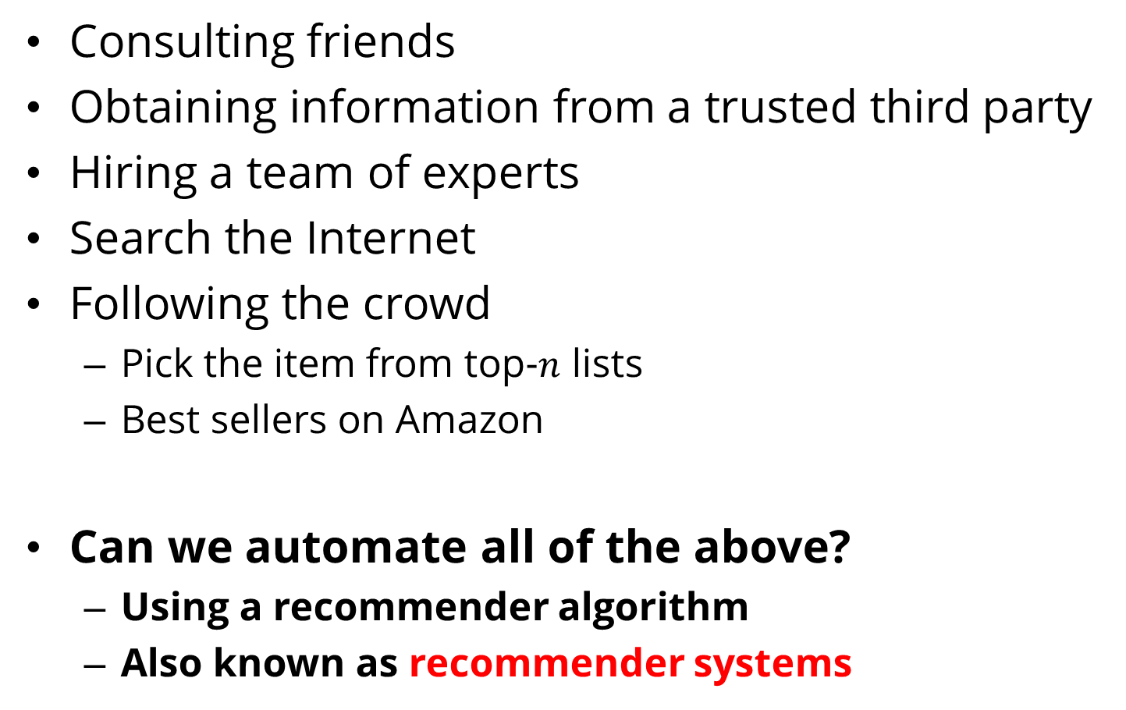
Common Solutions to the Problem
Consulting friends
Obtaining information from a trusted third party
Hiring a team of experts
Search the Internet
Following the crowd
Pick the item from top-$n$ lists
Best sellers on Amazon
Can we automate all of the above?
Using a recommender algorithm
Also known as recommender systems

Slide 6
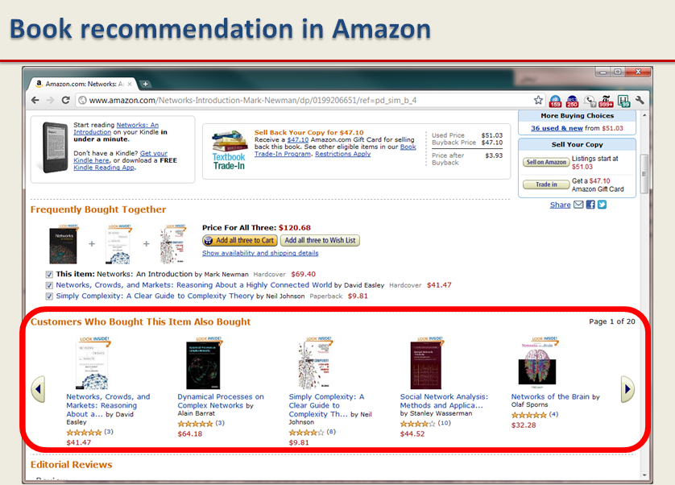
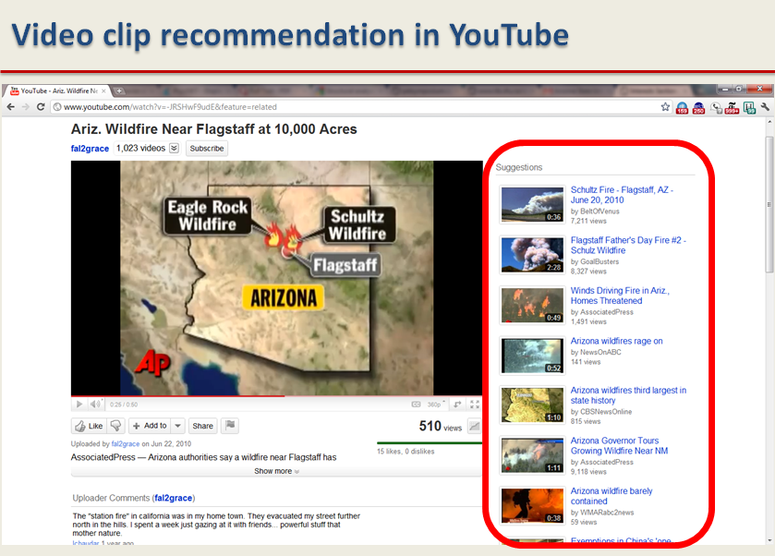
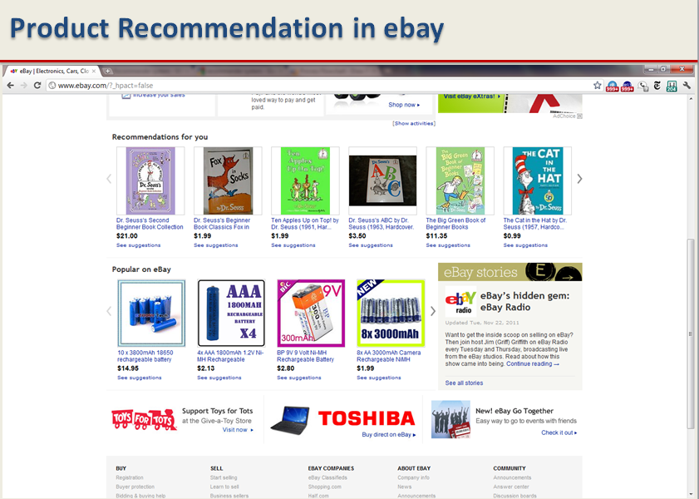
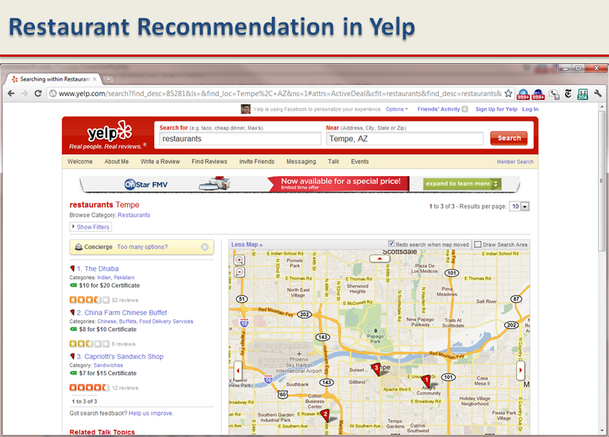
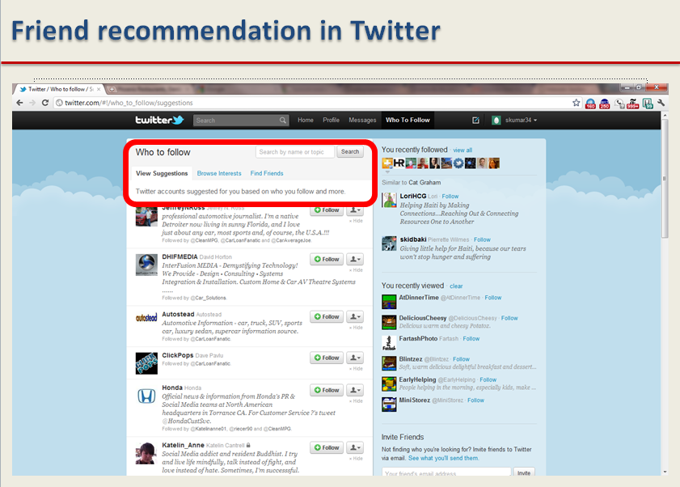
Recommender Systems - Examples

Slide 7

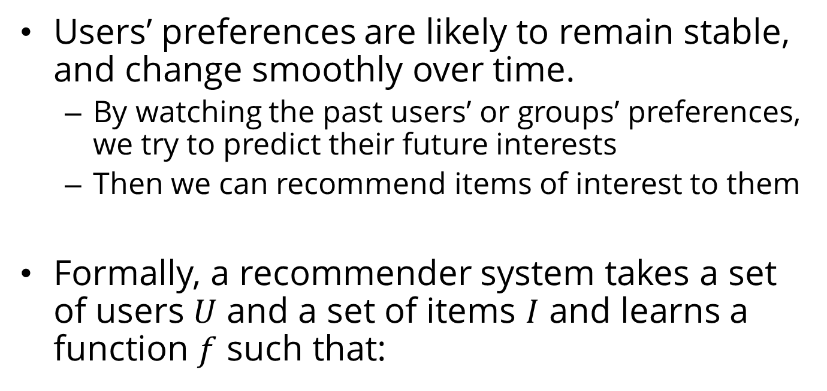
Main Idea behind Recommender Systems
Use historical data such as the user’s past preferences or similar users’ past preferences to predict future likes
Users’ preferences are likely to remain stable, and change smoothly over time.
By watching the past users’ or groups’ preferences, we try to predict their future interests
Then we can recommend items of interest to them
Formally, a recommender system takes a set of users $U$ and a set of items $I$ and learns a function $f$ such that:

Slide 8
Recommendation vs. Search
One way to get answers is using search engines
Search engines find results that match the query provided by the user
The results are generally provided as a list ordered with respect to the relevance of the item to the given query
Consider the query “best 2014 movie to watch”
The same results for an 8 year old and an adult
Search engines’ results are not customized

Slide 9
Challenges of Recommender Systems
The Cold Start Problem
Recommender systems use historical data or information provided by the user to recommend items, products, etc.
When user join sites, they still haven’t bought any product, or they have no history.
It is hard to infer what they are going to like when they start on a site.
Data Sparsity
When historical or prior information is insufficient.
Unlike the cold start problem, this is in the system as a whole and is not specific to an individual.

Slide 10
Challenges of Recommender Systems
Attacks
Push Attack: pushing ratings up by making fake users
Nuke attack: DDoS attacks, stop the whole recommendation systems
Privacy
Using one’s private info to recommend to others.
Explanation
Recommender systems often recommend items with no explanation on why these items are recommended

Slide 11
Classical Recommendation Algorithms
Content-based algorithms
Collaborative filtering

Slide 12
Content-Based Methods
Assumption: a user’s interest should match the description of the items that the user should be recommended by the system.
The more similar the item’s description to that of the user’s interest, the more likely that the user finds the item’s recommendation interesting.
Goal: find the similarity between the user and all of the existing items is the core of this type of recommender systems

Slide 13
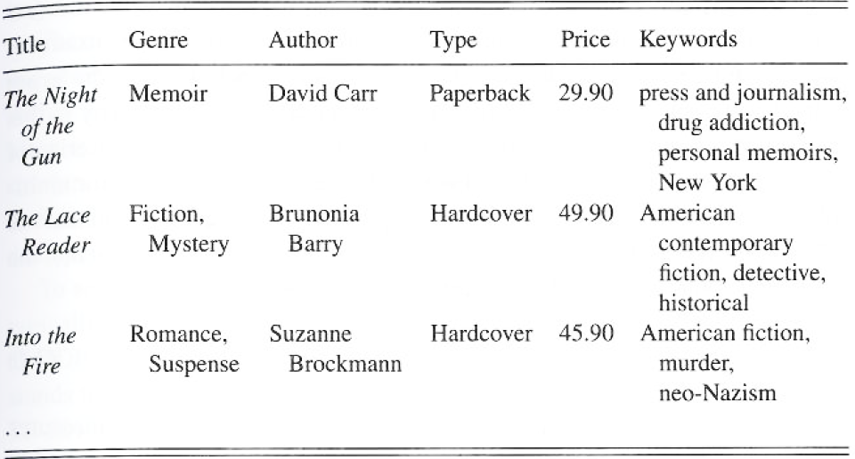
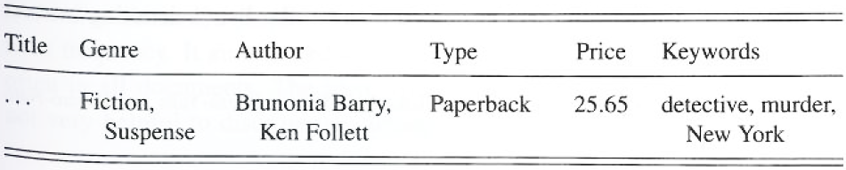
Content-based Recommendation: An Example
Book Database
User Profile

Slide 14
Content-based Recommendation Algorithm
Describe the items to be recommended
Create a profile of the user that describes the types of items the user likes
Compare items with the user profile to determine what to recommend
The profile is often created, and updated automatically in response to feedback on the desirability of items that are presented to the user

Slide 15
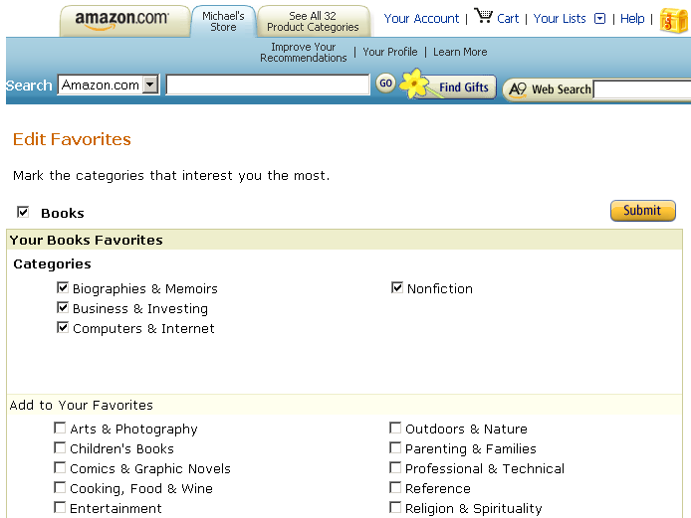
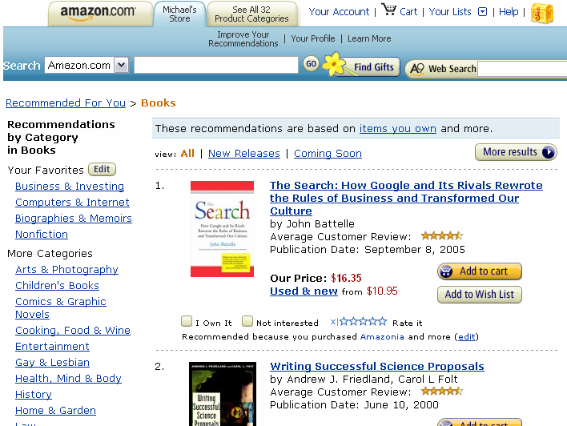
Content-based Recommendation: Example
User Profile
Items Recommended
Notes:
Left panel is user profile (or model), right panel is the recommendation result used the user profile.

Slide 16
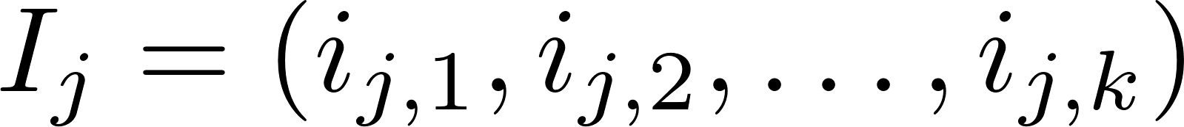
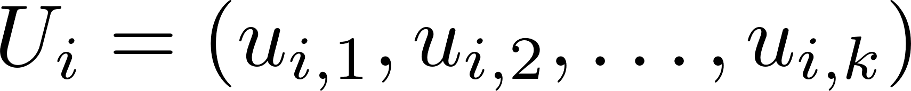
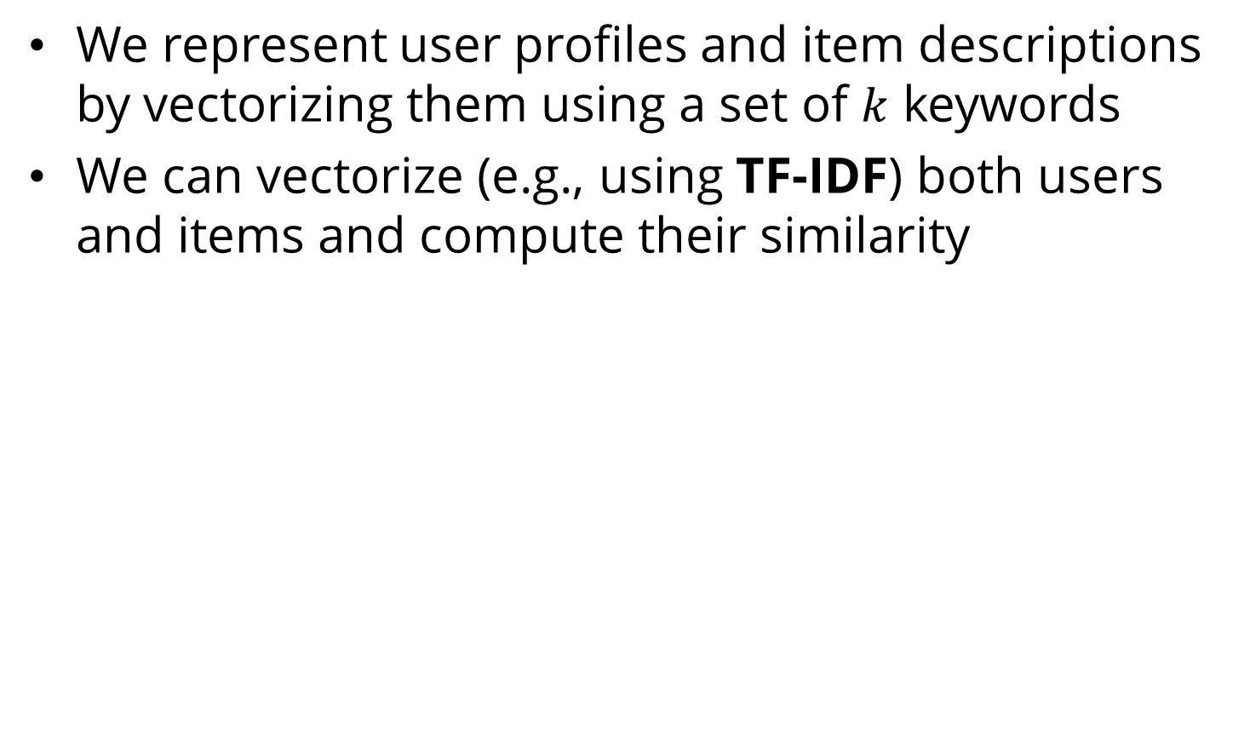
More formally
We represent user profiles and item descriptions by vectorizing them using a set of $k$ keywords
We can vectorize (e.g., using TF-IDF) both users and items and compute their similarity
We can recommend the top most similar items to the user

Slide 17
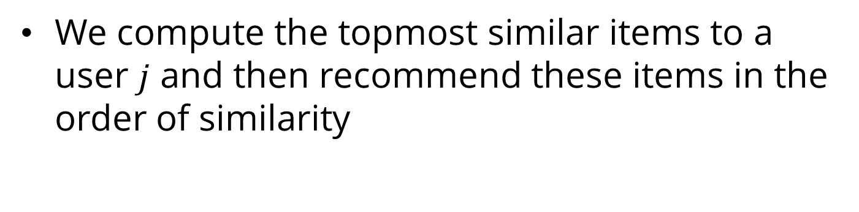
Content-Based Recommendation Algorithm
We compute the topmost similar items to a user $j$ and then recommend these items in the order of similarity

Slide 18
Collaborative Filtering
Collaborative filtering: the process of selecting information or patterns using techniques involving collaboration among multiple agents, viewpoints, data sources, etc.
Advantage: we don’t need to have additional information about the users or content of the items
Users’ rating or purchase history is the only information that is needed to work

Slide 19
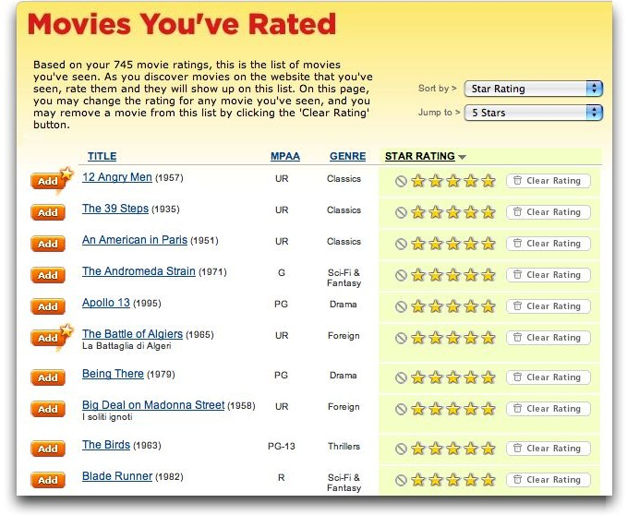
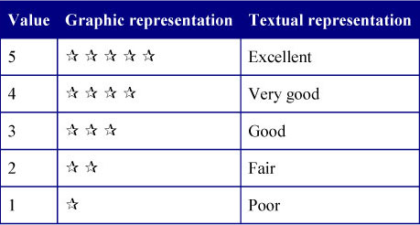
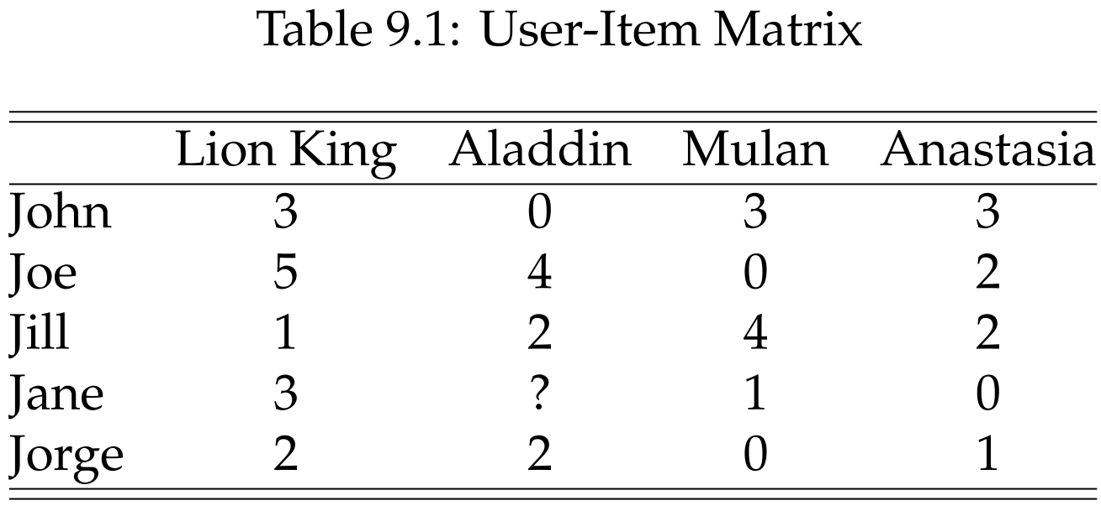
Rating Matrix: An Example

Slide 20
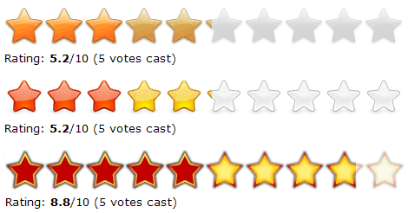
Rating Matrix
Users rate (rank) items (purchased, watched)
Explicit ratings:
entered by a user directly
i.e., “Please rate this on a scale of 1-5”
Implicit ratings:
Inferred from other user behavior
E.g., Play lists or music listened to, for a music Rec system
The amount of time users spent on a webpage

Slide 21
Collaborative Filtering
Types of Collaborative Filtering Algorithms:
Memory-based: Recommendation is directly based on previous ratings in the stored matrix that describes user-item relations
Model-based: Assumes that an underlying model (hypothesis) governs how users rate items.
This model can be approximated and learned.
The model is then used to recommend ratings.
Example: users rate low budget movies poorly

Slide 22
Memory-Based Collaborative Filtering
Two memory-based methods:
User-based CF
Users with similar previous ratings for items are likely to rate future items similarly
Item-based CF
Items that have received similar ratings previously from users are likely to receive similar ratings from future users

Slide 23
Collaborative Filtering: Algorithm
Weigh all users/items with respect to their similarity with the current user/item
Select a subset of the users/items (neighbors) as recommenders
Predict the rating of the user for specific items using neighbors’ ratings for the same (or similar) items
Recommend items with the highest predicted rank

Slide 24
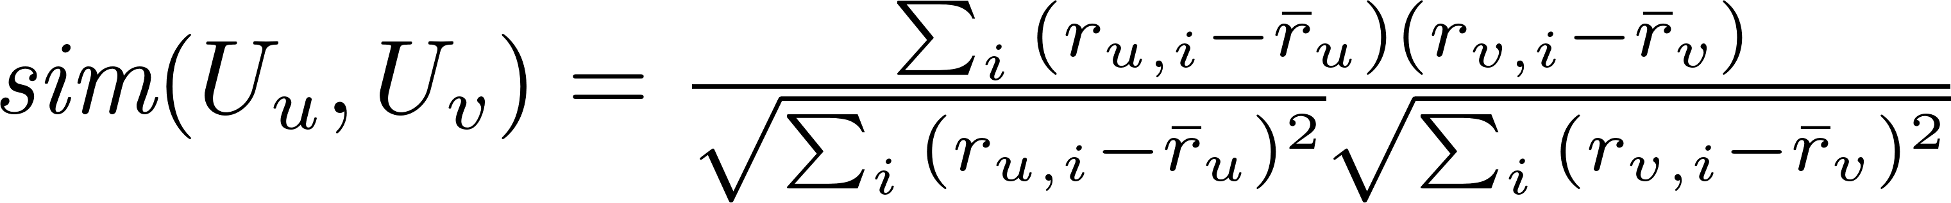
Measuring Similarity between Users (or Items)
Cosine Similarity
Pearson Correlation Coefficient
Notes:
Can we use Jaccard index J(A,B) = |A^B|/|AvB|

Slide 25
User-based Collaborative Filtering
User-based collaborative filtering
The system finds the most similar user (users) to the current user and uses their preferences for recommendation
The user-based approach is not as popular as the item-based approach
Why? With large number of users, even the smallest change in the user data is likely to reset the entire group of similar users

Slide 26
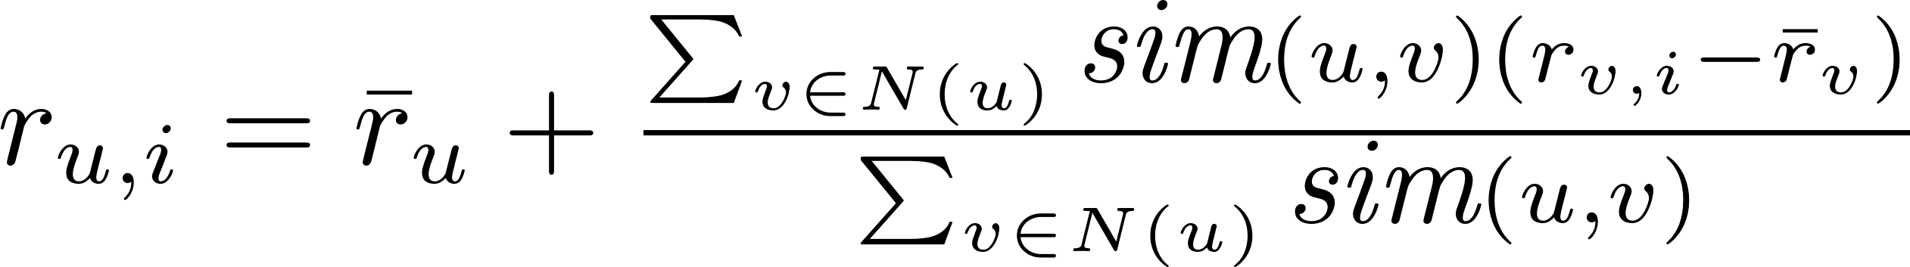
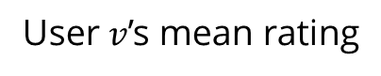
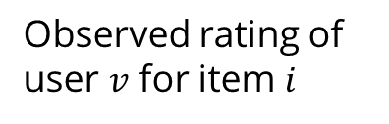
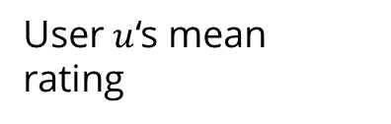
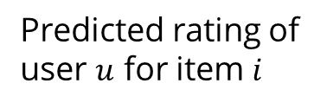
User-based CF
Updating the ratings:
User $v$’s mean rating
User $u$‘s mean rating
Predicted rating of user $u$ for item $i$
Observed rating of user $v$ for item $i$

Slide 27
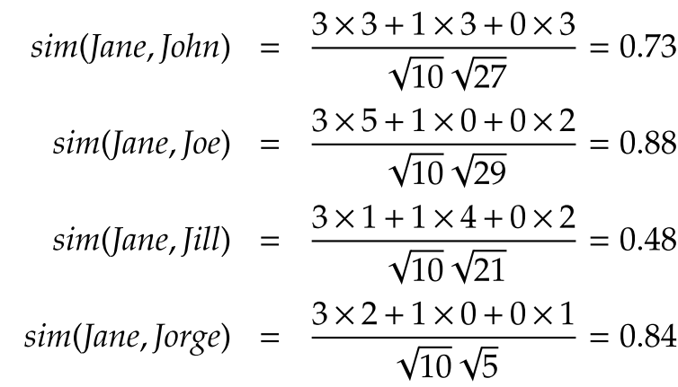
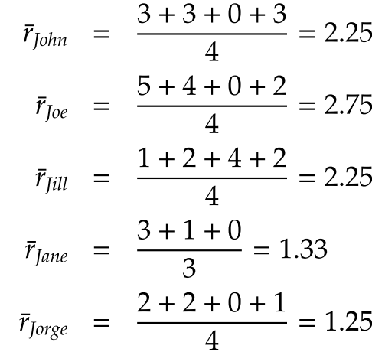
User-based CF, Example
Predict Jane’s rating for Aladdin
1- Calculate average ratings
2- Calculate user-user similarity
Notes:
Predict Jane’s rating for Aladdin

Slide 28
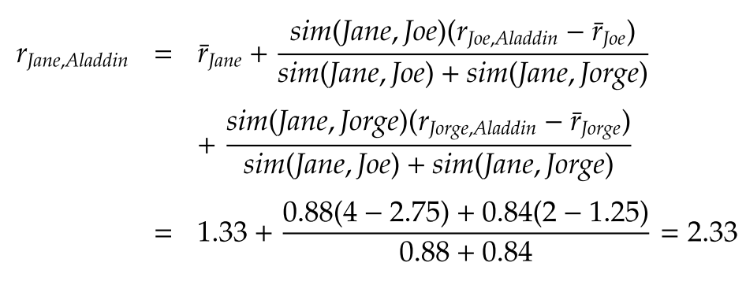
User-based CF, Example- continued
3- Calculate Jane’s rating for Aladdin, Assume that neighborhood size = 2

Slide 29
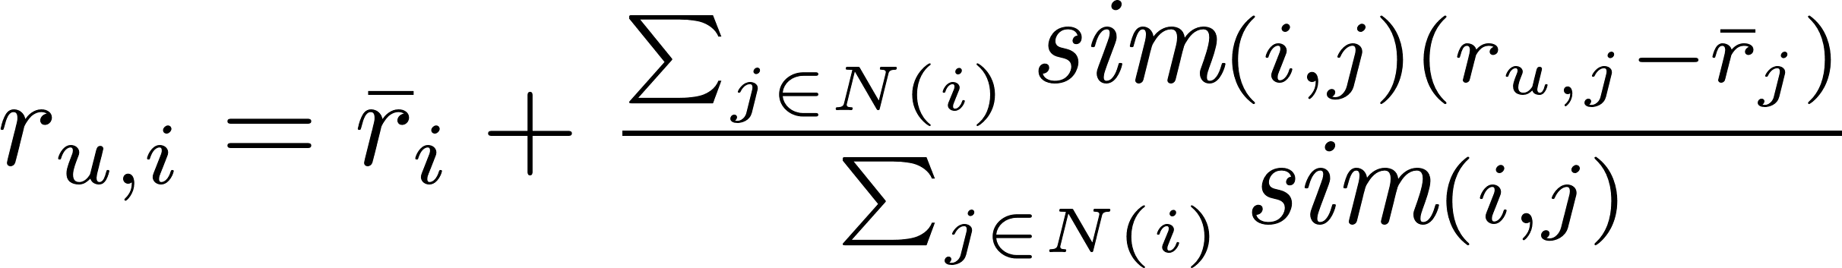
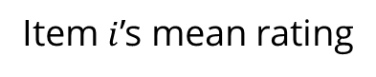
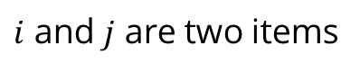
Item-based CF
Calculate the similarity between items and then predict new items based on the past ratings for similar items
Item $i$’s mean rating
$i$ and $j$ are two items

Slide 30
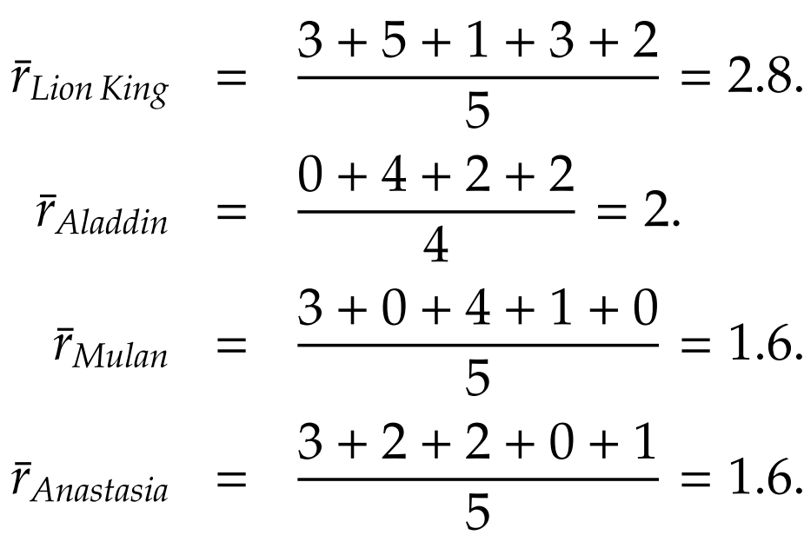
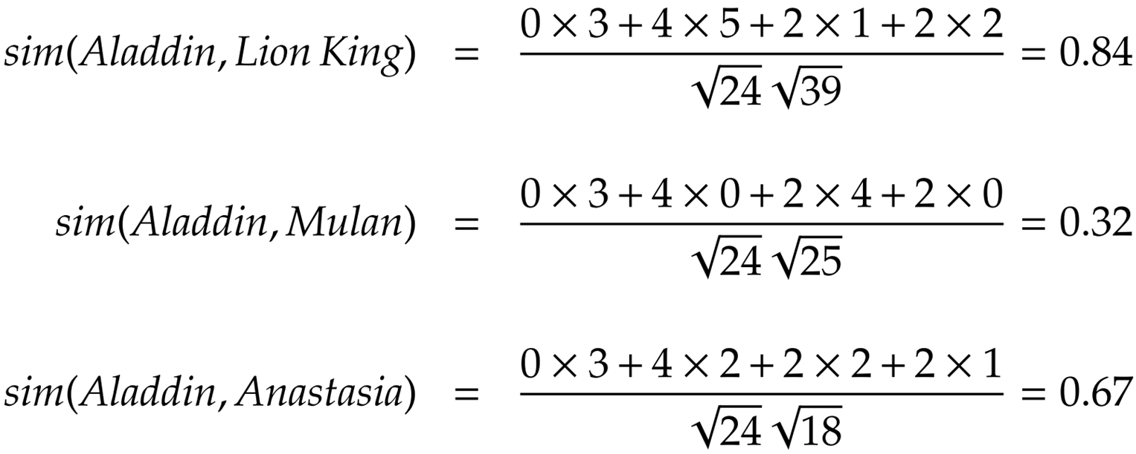
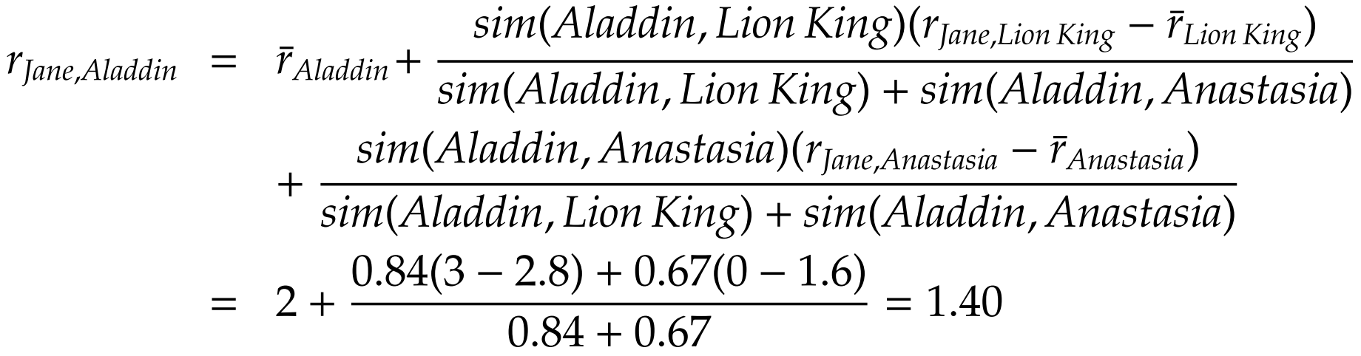
Item-based CF, Example
1- Calculate average ratings
2- Calculate item-item similarity
3- Calculate Jane’s rating for Aladdin, Assume that neighborhood size = 2

Slide 31
Model-Based Collaborative Filtering
In memory-based methods
We predict the missing ratings based on similarities between users or items.
In model-based collaborative ﬁltering
We assume that an underlying model governs how users rate.
We learn that model and use it to predict the missing ratings.
Among a variety of model-based techniques, we focus on a well-established model-based technique that is based on singular value decomposition (SVD).

Slide 32

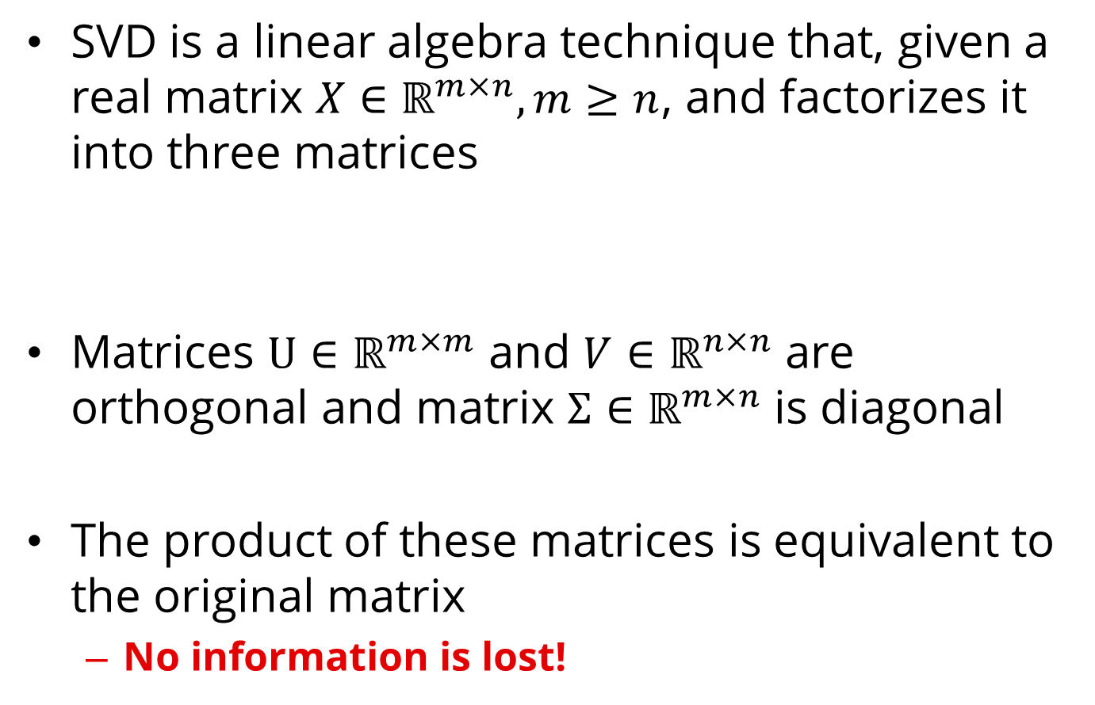
Singular Value Decomposition (SVD)
SVD is a linear algebra technique that, given a real matrix $X∈ℝ^{m×n}, m≥n$, and factorizes it into three matrices
Matrices $U∈ℝ^{m×m}$ and $V∈ℝ^{n×n}$ are orthogonal and matrix $Σ∈ℝ^{m×n}$ is diagonal
The product of these matrices is equivalent to the original matrix
No information is lost!

Slide 33
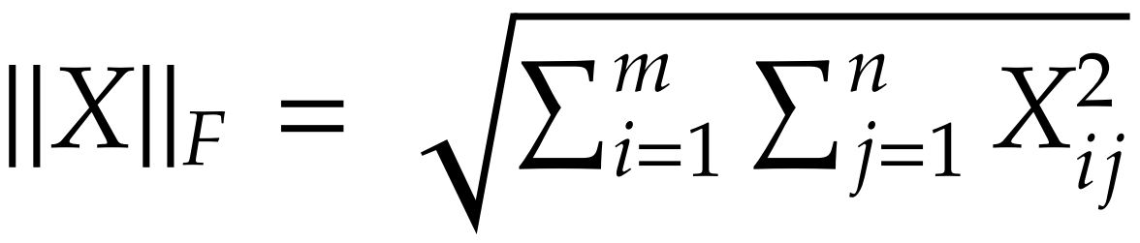
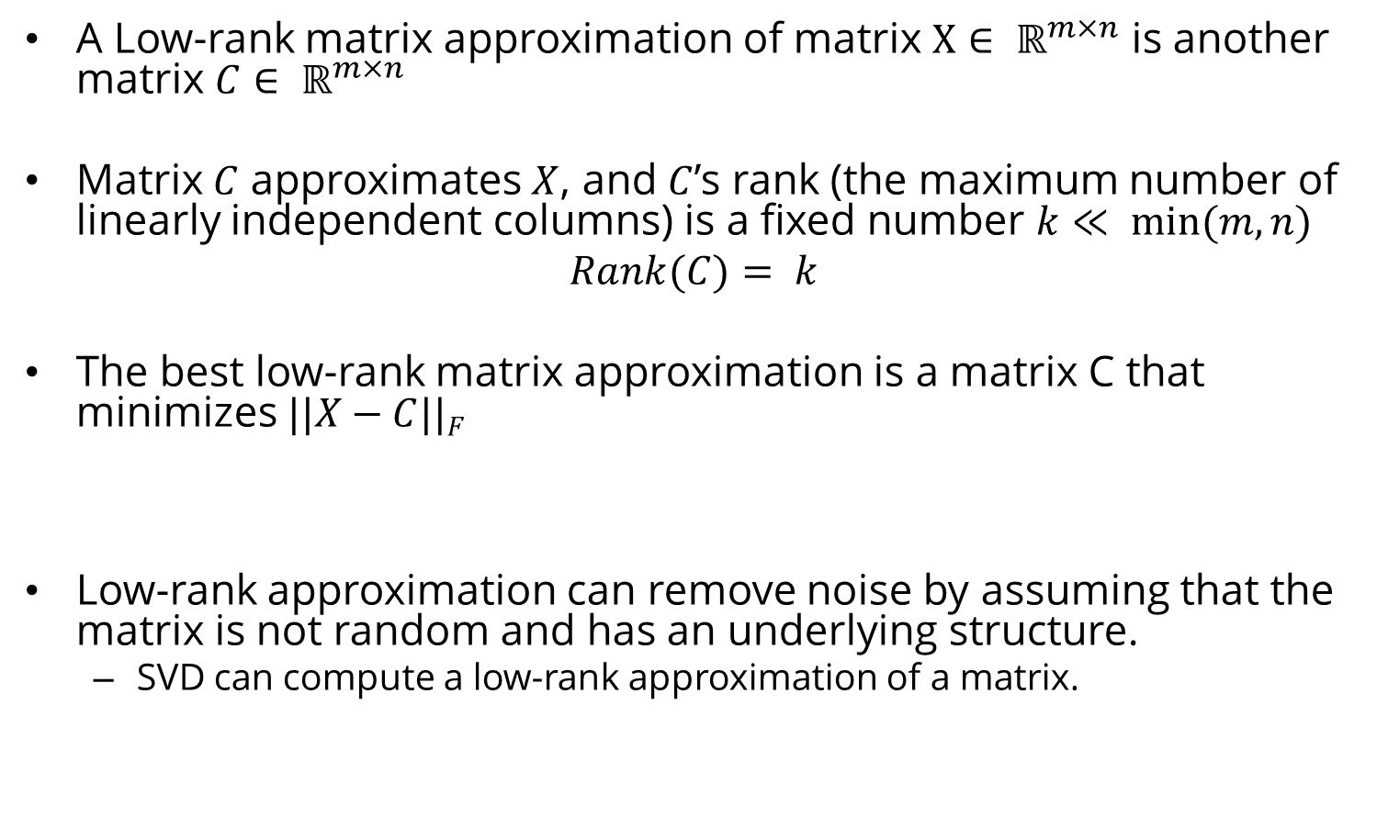
Low-rank Matrix Approximation
A Low-rank matrix approximation of matrix $X∈ ℝ^{m×n}$ is another matrix $C∈ ℝ^{m×n}$
Matrix $C$ approximates $X$, and $C$’s rank (the maximum number of linearly independent columns) is a ﬁxed number $k≪ min⁡(m, n)$
$$Rank(C)= k$$
The best low-rank matrix approximation is a matrix C that minimizes $||X−C||F$
Low-rank approximation can remove noise by assuming that the matrix is not random and has an underlying structure.
SVD can compute a low-rank approximation of a matrix.

Slide 34
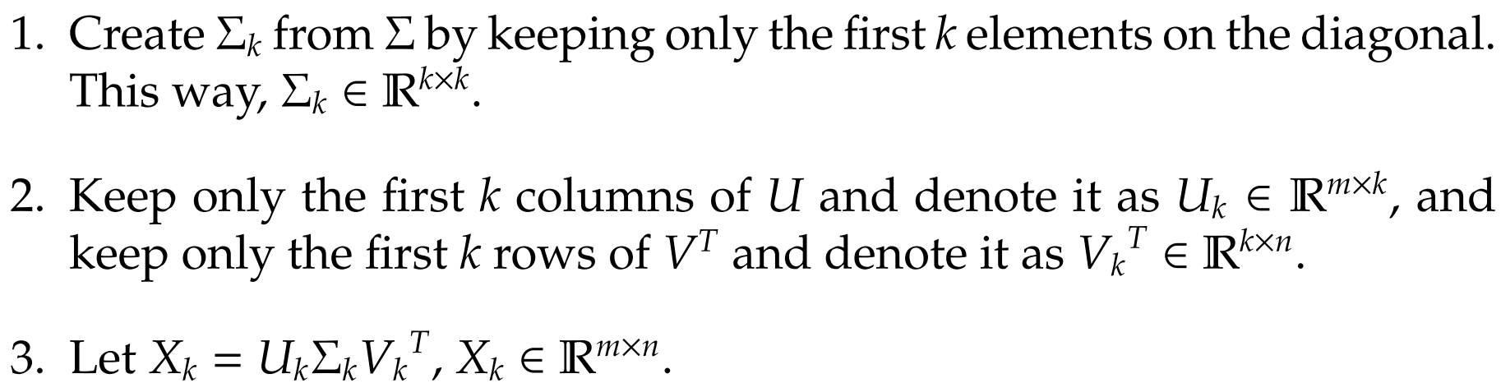
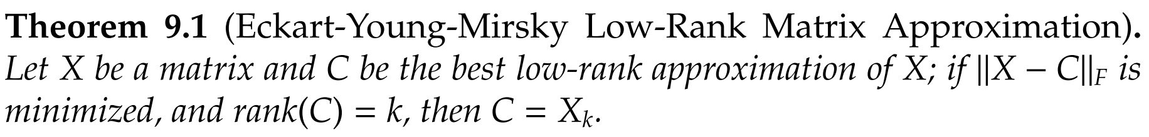
Low-Rank Matrix Approximation with SVD
$Xk$ is the best low-rank approximation of a matrix $X$

Slide 35
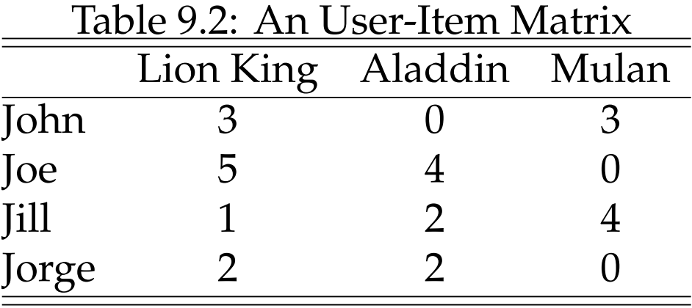
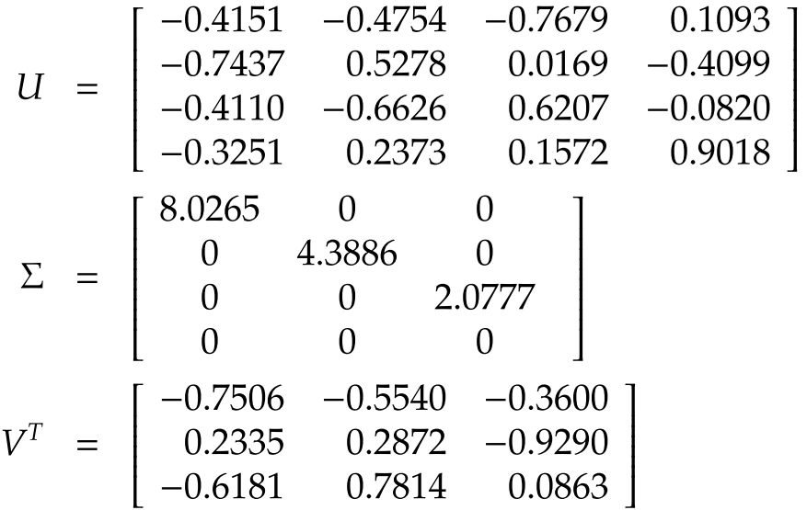
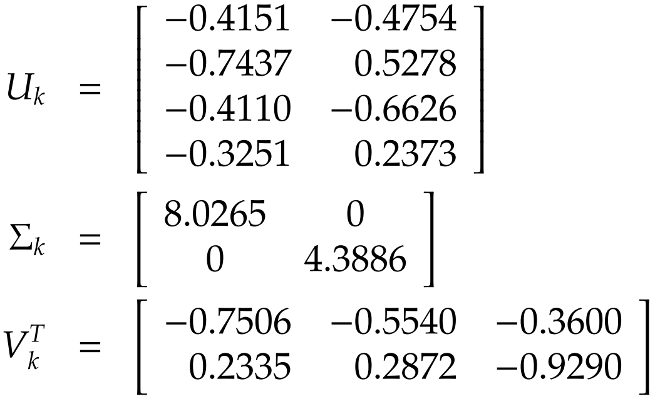
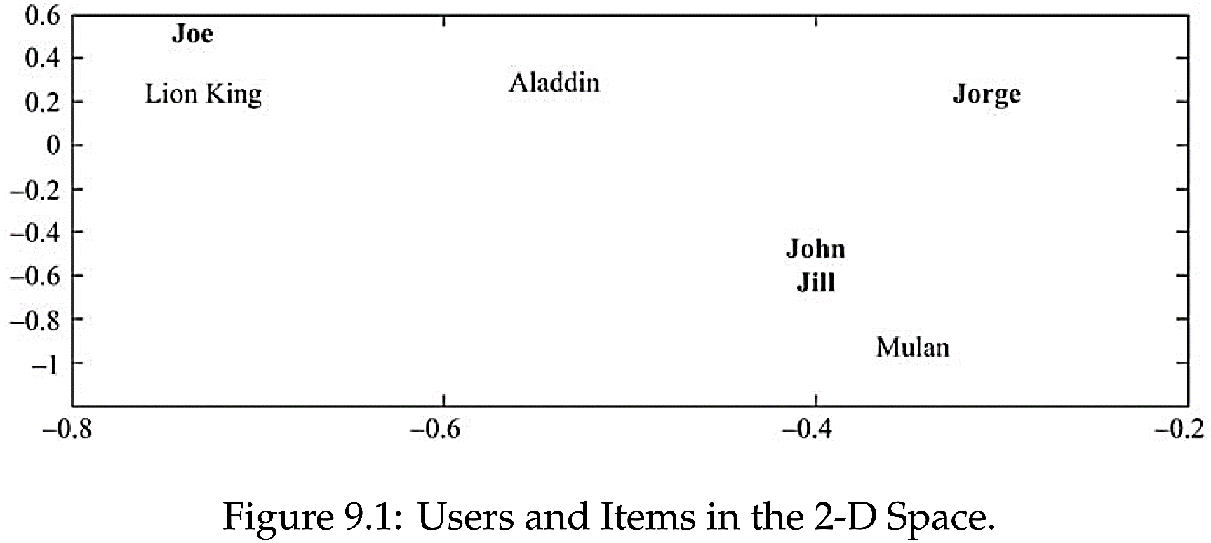
Model-based CF, Example
Considering a rank 2 approximation (i.e., k = 2), we truncate all three matrices:
Notes:
After most similar items or users are found in the lower k-dimensional space, one can follow the same process outlined in user-based or item-based collaborative ﬁltering to ﬁnd the ratings for an unknown item.
For instance, we showed in Example 9.3 (see Figure 9.1) that if we are predicting the rating r_{Jill,Lion} King and assume that neighborhood size is 1, item-based CF uses r_{Jill,Aladdin} , because Aladdin is closest to Lion King. Similarly, user-based collaborative ﬁltering uses r_{John,Lion} King , because John is the closest user to Jill.

Slide 36
Recommendation to a Group

Slide 37
Recommendation to Groups
Find content of interest to all members of a group of socially acquainted individuals
Examples:
A movie for friends to watch together
A travel destination for a family to spend a break
A good restaurant for colleagues to have lunch
A music to be played in a public area

Slide 38
Tasks of a Group Recommender System
Acquiring preferences
Generating recommendations
Explaining recommendations
Helping group members to achieve consensus

Slide 39
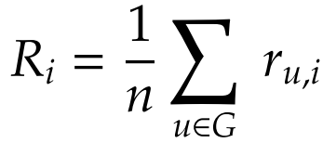
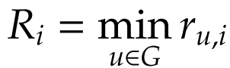
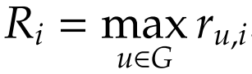
Aggregation Strategies
Maximizing Average Satisfaction
Average everyone’s ratings and choose the max
Least Misery
This approach tries to minimize the dissatisfaction among group’s members (max of all mins)
Most Pleasure
The maximum of individuals’ maximum ratings is taken as group’s rating
Notes:
Non-Preference Aggregation (See the four methods in slide): Max(averages of all), Max(least’s of all), Max(max’s of all)
Preference Aggregation
Merging of recommendations made for individuals
Aggregation of ratings for individuals
Construction of group preference models

Slide 40
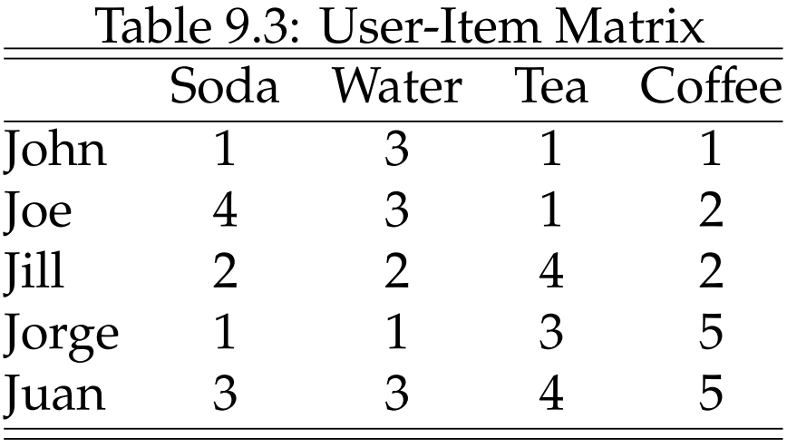
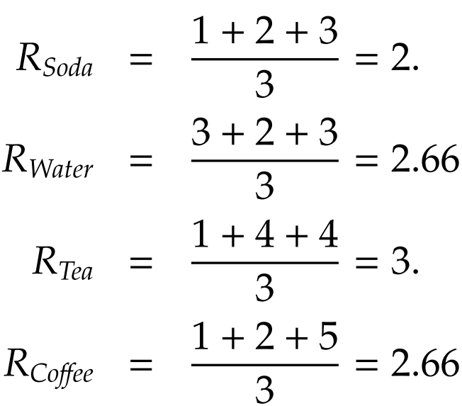
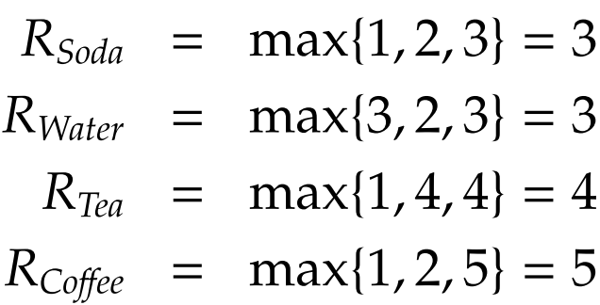

Recommendation to Group, an Example
Average Satisfaction
Least Misery
Most Pleasure
Notes:
Average Satisfaction

Slide 41
Recommendation Using Social Context
Recommendation using social context alone
Extending classical methods with social context
Recommendation constrained by social context

Slide 42

Information Available in Social Context
In social media, in addition to ratings of products, there is additional information
E.g., the friendship network
This information can be used to improve recommendations
Assuming that friends have an impact on the ratings ascribed by the individual.
This impact can be due to homophily, inﬂuence, or confounding
Notes:
Recommendation using Social Context. When utilizing social information, we can 1) utilize this information independently, 2) add it to user-rating matrix, or 3) constrain recommendations with it.

Slide 43
I. Recommendation Using Social Context Alone
Consider a network of friendships for which no user-item rating matrix is provided.
In this network, we can still recommend users from the network to other users for friendship.
This is an example of friend recommendation in social networks [Next Chapter!]

Slide 44


II. Extending Classical Methods
Using Social information in addition to a user-item rating matrix to improve recommendation.
Addition of social information:
We assume that friends rate similar items similarly.
Optimize only for non-zero elements
Notes:
R: Rating matrix,
U: New representation for users
Lambda_1 and Lambda_2 are predefined non-negative constants

Slide 45



Modeling Social Information in Recommendation
Incorporating similarity: The taste for user $i$ is close to that of all his friends $j∈F(i)$
$sim(i, j)$denotes the similarity between user $i$ and $j$ (e.g., cosine between their ratings)
$F(i)$ denotes the friends of $i$
Final Formulation:
Controlling Sparsity
Notes:
where β is the constant that controls the eﬀect of social network regularization.
A local minimum for this optimization problem can be obtained using gradient-descent-based approaches. To solve this problem, we can compute the gradient with respect to U_{i}’s and V_{i}’s and perform a gradient descent-based method.

Slide 46


3. Recommendation Constrained by Social Context
In classical recommendation,
To estimate ratings, we determine similar users or items.
Any user similar to the individual can contribute to the predicted ratings for the individual.
We can limit the set of individuals that can contribute to the ratings of a user to the set of friends of the user.
$S(i)$ is the set of $k$ most similar friends of an individual

Slide 47





Example
Average Ratings
User Similarity
Notes:
Average rating

Slide 48
Evaluation of Recommender Systems

Slide 49
Evaluating Recommender Systems is difficult
Different algorithms may be better or worse on different datasets (applications)
Many algorithms are designed specifically for datasets where there are many more users than items or vice versa.
Similar differences exist for rating density, rating scale, and other properties of datasets
The goals to perform evaluation may differ
Early evaluation work focused specifically on the "accuracy" of algorithms in "predicting" withheld ratings.
Other properties different from accuracy also have important effect on user satisfaction and performance
There is a significant challenge in deciding what combination of measures should be used in comparative evaluation

Slide 50
Evaluating Recommender Systems
A myriad of algorithms are proposed, but
Which one is the best in a given application domain?
What are the success factors of different algorithms?
Comparative analysis based on an optimality criterion?
Main questions are:
Is a RS efficient with respect to specific criteria like accuracy, user satisfaction, response time, etc.
Do customers like/buy recommended items?
Do customers buy items they otherwise would have not?
Are they satisfied with a recommendation after purchase?
Notes:
Serendipity
ramp-up efforts

Slide 51
How Do We Evaluate Recommenders
Application outcomes
Add-on sales
Click-through rates
The number of products purchased
And not returned!
Research measures
User satisfaction
Metrics
To anticipate the above beforehand (offline)

Slide 52
Accuracy Metrics
Predictive accuracy
How close are the recommender system’s predicted ratings are to the true user ratings?
Classification accuracy
The ratio with which a recommender system makes correct vs. incorrect decisions about whether an item is good.
Classification metrics are thus appropriate for tasks such as Find Good Items when users have binary preferences.
Rank accuracy

Slide 53



I. Predictive accuracy - Metrics measure error rate
Mean Absolute Error (MAE). The average absolute deviation between a predicted rating ($p$) and the user’s true rating ($r$)
$NMAE = MAE/(rmax – rmin)$
Root Mean Square Error (RMSE). Similar to MAE, but places more emphasis on larger deviation

Slide 54


Evaluation Example

Slide 55



II. Classification Accuracy: Precision and Recall
Precision: a measure of exactness, determines the fraction of relevant items retrieved out of all items retrieved
Recall: a measure of completeness, determines the fraction of relevant items retrieved out of all relevant items

Slide 56


Evaluating Relevancy, Example

Slide 57

III. Evaluating Ranking of Recommendation
Spearman’s Rank Correlation
$$ρ=1− \frac{6\sum_{i=1}^{n}{\left(xi −yi\right)2}}{n3−n}$$
Kendall’s $τ$
Compares concordant the items of the recommended ranking list against the ground truth ranking list
If the two orders are consistent, it is concordant
E.g., for top 4 items in ranking list, there are 4$×$3/2=6 pairs
$τ$ = $\frac{c−d}{\left({n \atop 2}\right)}$
$c$ is the number of concordants
$d$ is the number of disconcordants

Slide 58



Ranking, Example
Consider a set of four items $I = \{i1 , i2 , i3 , i4\}$for which the predicted and true rankings are as follows
Pair of items and their status {concordant/discordant} are

Slide 59
Extra Slides

Slide 60
Beyond Accuracy, Relevance, and Rank
Coverage
Measure of the domain of items in the system over which the system can form predictions or make recommendations
Novelty and Serendipity
Helping users to find a surprisingly interesting item he might not have otherwise discovered
Confidence
How sure is the RS that its recommendation is accurate?
Diversity
Risk
Robustness
Privacy
Adaptivity
Scalability

Slide 61
Content Recommendation in Social Media

Slide 62
Video Recommendation
Related videos defined as videos that a user is likely to watch after having watched a video
Approaches to video recommendation:
Association rule mining
co-visitation

Slide 63

Video Recommendation: Association Rule Mining
System calculates the probability of watching v_{j} after the user watched v_{i} and recommends top-N of highly ranked videos
Notes:
This is basically a measure called Confidence

Slide 64

Video Recommendation: Co-visitation
Co-visitation score is a number that shows in a given time period, how often two videos co-watched within sessions
c_{ij} is the number of co-watches for videos v_{i} and v_{j} and f (v_{i}, v_{j}) is a normalization factor regarding the popularity of two videos, e.g., e the product of the videos’ popularity (the number of views).
Notes:
A video’s popularity is its number of views.

Slide 65
Tag Recommendation
Tag recommendation is the process of recommending appropriate tags to be applied by the user per specific item annotation
Approaches:
Recommending the most popular tags
Collaborative Filtering
Content-based Tag Recommendation
Graph-based

Slide 66
Tag Recommendation: Popularity-based and CF Approaches
Recommend the most popular tags
Popular tags already assigned for the target item
Frequent tags previously used by the user, and
Tags co-occurred with already assigned tags.
Collaborative filtering
It can use item-based or user-based approaches.
Or it may use a hybrid approach by recommending tags given by similar users to similar items.

Slide 67
Tag Recommendation: Content- and Graph-based Approaches
Content-based Tag Recommendation
This can be done by recommending keywords from the item’s associated text or tags that have the highest co-occurrence with important keywords.
Graph-based Approaches
The FolkRank algorithm is an example. Its idea is: a resource which is tagged with tags by important users should be important.

Slide 68
News Recommendation
A recommended news should be of interest to the user if it is recent or fresh, diverse, and not very similar (the same) to the other news the user recently read.
Regular recommender systems might not be used for news as recency is one of the most important factors for a piece of news.

Slide 69
Blog Recommendation
The blog recommendation is the task of finding relevant blogs in response to a query
Blog relevance ranking differs from classical document retrieval and ranking in several ways:
How to deal with blog posts
How to come up with reliable queries as user queries represent current interests in the topic

Slide 70
Blog Recommendation: An Algorithm
A solution for the first problem is using two different document models
Large document model: entire blog as a whole
Small document model: each blog post as a document.
The second problem can be solved by query expansion
Query Expansion (QE) is the process of reformulating a seed query to improve retrieval performance in information retrieval operations).
Using wikipedia is an often used method for query expansion: the query is sent to Wikipedia, and the retrieved wiki articles are now new queries and will be used for blog searching.
After solving these two problems of blogs, we can use existing recommendation systems to get the blog recommendation.

Slide 71
Social Media Content Recommendation: Tag Based
People use tags to summarize, remember, and organize information.
Tags are a powerful tool for social navigation, helping people to share and discover new information contributed by other community members.
Tags promote social navigation by their vocabulary, or the set of tags used by members of the community.
Instead of imposing controlled vocabulary or categories, tagging systems’ vocabulary emerges organically from the tags chosen or created by individual members.
A tag-based recommendation system uses tags to recommend items.

Slide 72
Tag Based Recommendation
Algorithms combining tags with recommenders provide both the automation inherent in recommenders, and the ﬂexibility and conceptual comprehensibility inherent in the tagging system.

Slide 73
Hybrid Approaches to Recommendation

Slide 74
Pipeline hybridization
This approach uses more than one recommender system and puts the recommender systems in a line.
The result of one recommender is the input for another one.
The earlier recommender can make a model of the input and pass it to the next recommender system or can generate a list of recommendations to be used by the next recommender system.

Slide 75
Parallelized hybridization
We use more than one recommender algorithm.
The hybridization process gets the result of recommenders, combines them and generates the final recommendation.
Different methods can be used to combine the results of other recommenders such as:
Mixed (a union of results from all recommender systems),
Weighted (a weighted combination of the results),
Switching (use results from specific recommender systems for specific tasks),
Majority voting.

Slide 76
Recommendation Explanation
The digital camera X is the best for you because …

Slide 77
Confidence
Why would someone distrust a recommendation?
Can I trust the provider?
How does this work, anyway?
Does the system know enough about me?
Does the system know enough about the item it is recommending?
How sure is it?

Slide 78
The Confidence Challenge
Why should users believe recommendations?
When should users believe them?
Approaches
Confidence indicators
Explain the recommendations
Reveal data and processes
Corroborating data, track records
Offer opportunities to correct mistaken data

Slide 79
Explanations in recommender systems
Motivation
"The digital camera Profishot is a must-buy for you because . . . ."
Why should recommender systems should deal with explanations at all?
The answer is related to the two parties providing and receiving recommendations:
A selling agent may be interested in promoting particular products
A buying agent is concerned about making the right buying decision
Additional information to explain the system`s output following some objectives

Slide 80
Objectives of explanations
Transparency
Provide information such that the user can comprehend the reasoning used to generate a specific recommendation
Validity
Explanations can be generated in order to allow a user to check the validity of a recommendation
Trustworthiness
Explanations aiming to build trust in recommendations reduce the uncertainty about the quality of a recommendation
Comprehensibility
Explanations targeting comprehension support the user by relating her known concepts to the concepts employed by the recommender
Education
Deep knowledge about the domain helps the customer rethink her preferences and evaluate the pros and cons of different solutions

Slide 81
Objectives of explanations
Persuasiveness
In this sense persuasive explanations for recommendations aim to change the user's buying behavior
Effectiveness
The support a user receives for making high-quality decisions
Efficiency
A system's ability to support users in order to reduce the decision-making effort e.g. time
Satisfaction
Explanations can attempt to improve the overall satisfaction stemming from the use of a recommender system.
Relevance
Additional information may be required in conversational recommenders. Explanations can be provided to justify why additional information is needed from the user

Slide 82



Examples
Similarity between items
Similarity between users
Tags
Tag relevance (for items)
Tag preference (of users)

Slide 83
Explanation types
Nearest neighbor explanation
Customers who bought item X also bought items Y,Z
Item Y is recommended because you rated related item X
Content based explanation
This story deals with topics X,Y which belong to your topic of interest
Social-network based explanation
People leverage their social network to reach information and make use of trust relationships to filter information.
Your friend X wrote that blog
50% of your friends liked this item (while only 5% disliked it)

